Slide 1

OLA Ride Booking Analysis
An End-to-End Business Intelligence Project
Author
Program
Aryan Rai
B.Tech CSE (AI & DS)
Institution
Graduation
IIMT College of Engineering
2027
This deck is designed for recruiters and hiring managers. Every card is self-contained — read linearly or jump to any section.

Slide 2

Project at a Glance: 40,000 Rides, One BI Pipeline
A full-cycle business intelligence engagement — from raw operational data to an interactive, multi-view Power BI dashboard — built to surface fleet, revenue, and cancellation insights for a ride-booking platform modeled on OLA's July 2024 data.
1
2
Dataset
Tech Stack
~40,000 ride booking records covering July 2024. Fields include booking status, vehicle type, ride distance, booking value, payment method, and customer/driver ratings.
Microsoft Excel (data storage) → Power Query (ETL) → SQL / MySQL (analysis) → Power BI (interactive dashboards)
3
4
Objective
Deliverable
Transform raw operational data into actionable business insights supporting fleet management, revenue optimization, and cancellation reduction.
5-view interactive Power BI dashboard — Overall, Vehicle Type, Revenue, Cancellation, and Ratings views.

Slide 3
Data Pipeline: From Raw Excel to BI-Ready Dataset
Source Format
Power Query ETL Steps
40,000 records · 20 columns · Microsoft Excel
Key fields: Booking_ID, Customer_ID, Vehicle_Type, Booking_Status, Pickup/Drop Location, Ride_Distance, Booking_Value, Ratings
Imported dataset into Power BI via Power Query connector
Validated and corrected data types for all 20 columns
Standardized column headers for consistent referencing
Reviewed, flagged, and resolved missing values and duplicate records
Outcome
Key Skill Demonstrated
Clean, structured dataset with consistent formats — a reliable foundation for SQL querying and dashboard visualization.
End-to-end ETL pipeline design using Power Query, ensuring data quality is enforced before analysis begins.

Slide 4
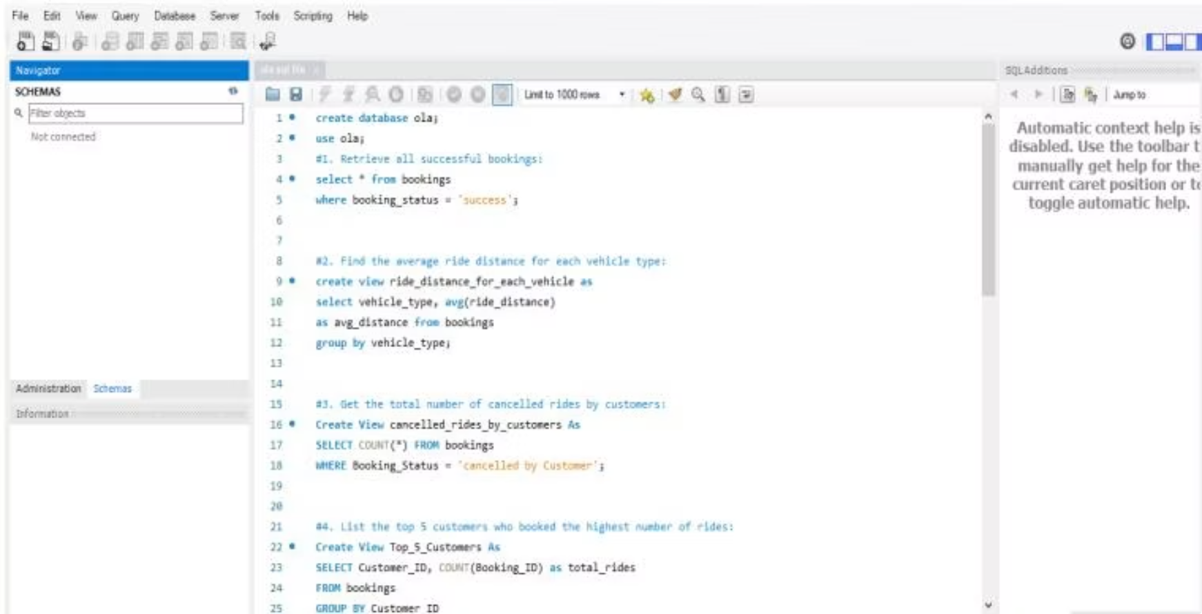
SQL Analysis: Business Questions Answered with Queries
Database Setup
Reusable SQL Views Created
Created a dedicated MySQL database, imported the cleaned dataset, and structured it for relational querying. Core aggregation functions used: COUNT(), SUM(), AVG() — applied with WHERE, GROUP BY, and ORDER BY clauses for filtering and segmentation.
ride_distance_for_each_vehicle
Top_5_Customers
cancelled_rides_by_customers
Key Queries Built
Business Value
Retrieve all successful bookings
Average ride distance per vehicle type
Total customer-cancelled rides
Top 5 customers by booking volume
Revenue breakdown by vehicle category
The SQL layer enabled scalable, repeatable analysis. All query results served as the direct data foundation for Power BI visualizations — ensuring every dashboard figure is traceable to a specific query.

Slide 5
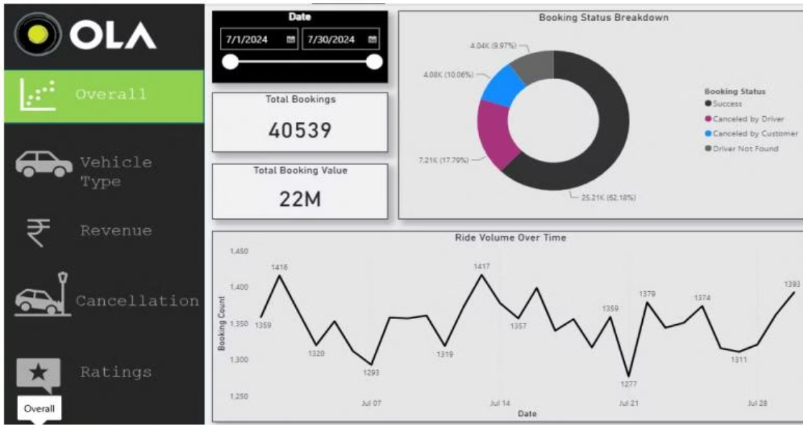
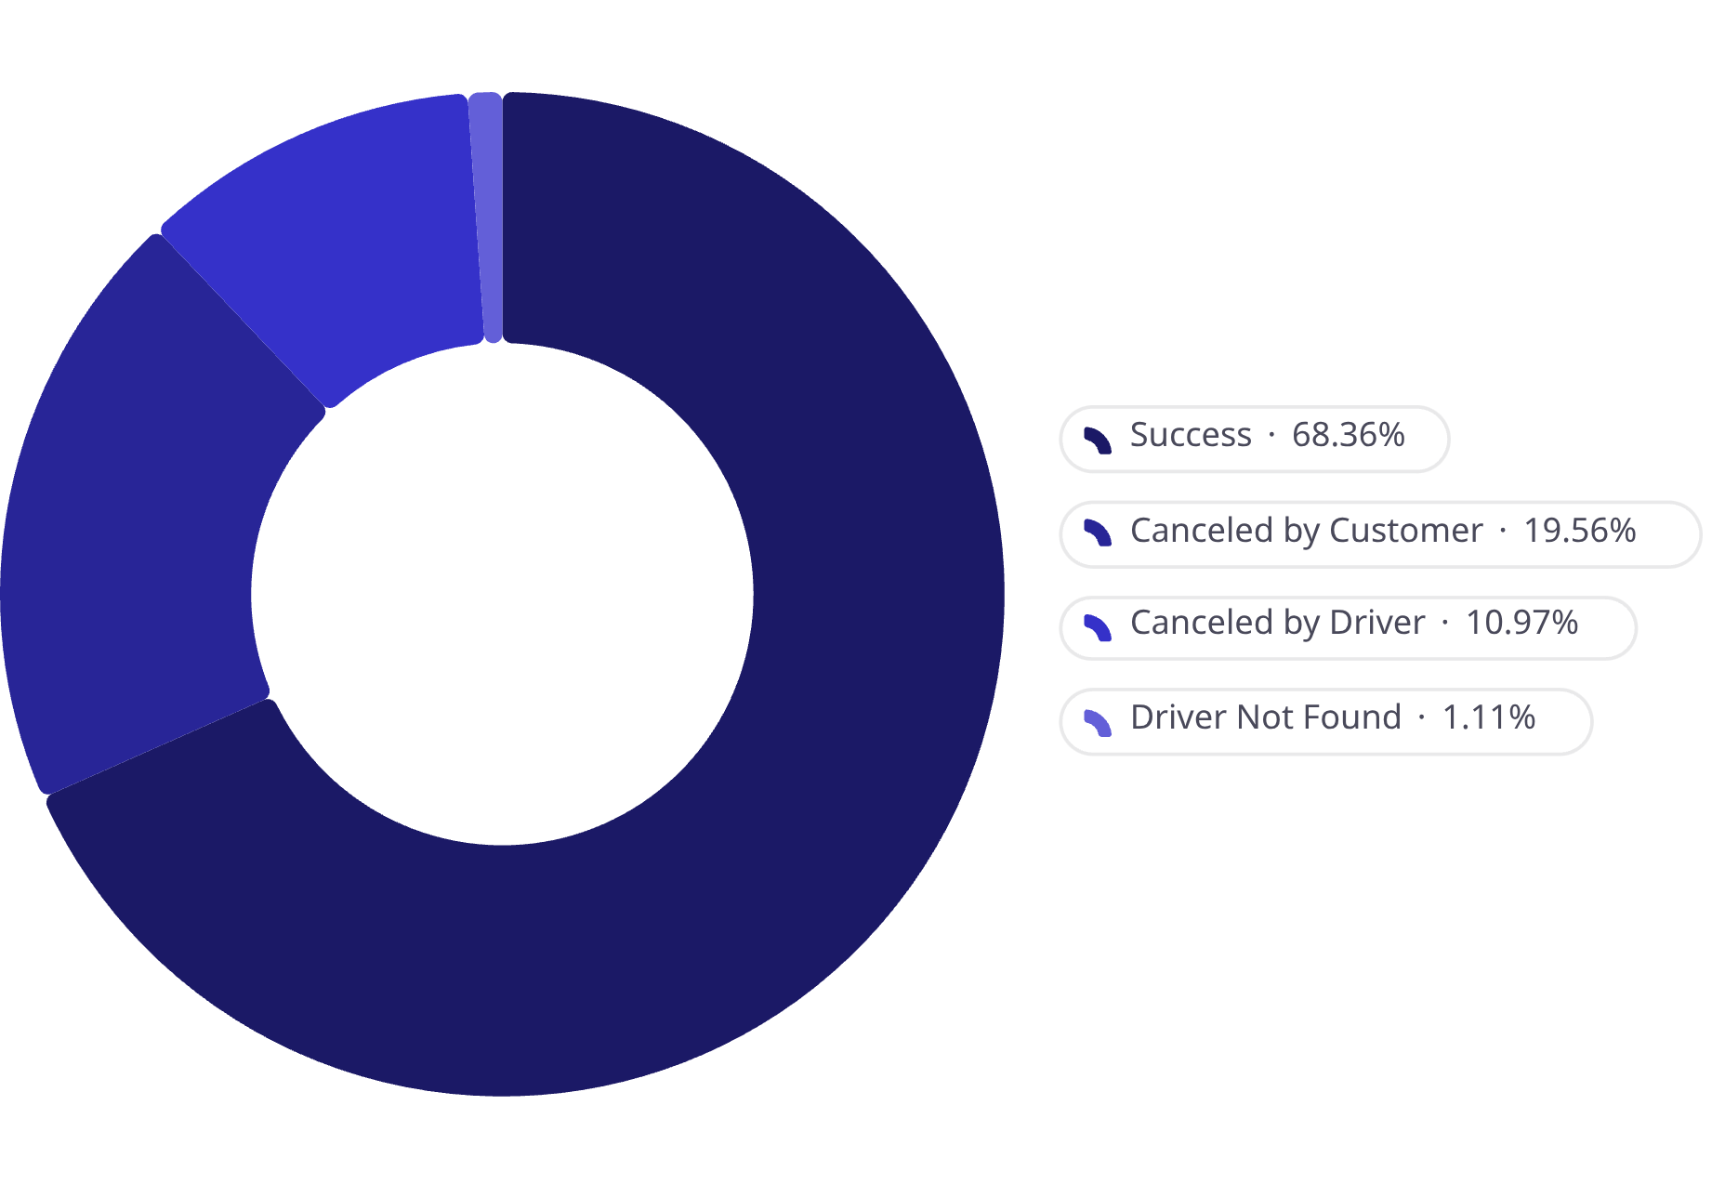
Executive Dashboard: July 2024 KPI Snapshot
40,539
₹22M
Total Bookings
Total Booking Value
July 1–30, 2024
Gross revenue across all booking statuses
82.18%
26.6%
Success Rate
Cancellation Rate
25,216 completed rides
Combined customer + driver cancellations
Ride Volume Trend
Daily bookings ranged between ~1,277 and 1,417 across the month. Peak days observed on Jul 7 (1,416) and Jul 14 (1,417) — suggesting a recurring weekly demand cycle worth investigating for fleet pre-positioning.
Dashboard Design
Donut chart for booking status distribution combined with a line chart for daily ride volume — enables at-a-glance operational monitoring without information overload.

Slide 6
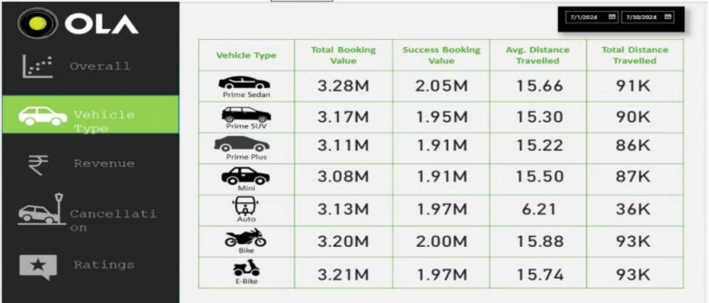

Vehicle Performance: Revenue & Distance by Category
Vehicle Type
Total Booking Value
Success Booking Value
Avg. Distance (km)
Total Distance
Prime Sedan
₹3.28M
₹2.05M
15.66
91K km
Prime SUV
₹3.17M
₹1.95M
15.30
90K km
Prime Plus
₹3.11M
₹1.91M
15.22
86K km
Mini
₹3.08M
₹1.91M
15.50
87K km
Auto
₹3.13M
₹1.97M
6.21
36K km
Bike
₹3.20M
₹2.00M
15.88
93K km
E-bike
₹3.21M
₹1.97M
15.74
93K km
Top Revenue Generator
Highest Distance Per Ride
Auto Category Outlier
Prime Sedan leads with ₹3.28M total booking value and ₹2.05M in successful bookings — the highest conversion of any category.
Bike (15.88 km) and E-bike (15.74 km) log the longest average trips, each generating ~₹3.20–3.21M total value despite lower per-km fares.
Auto averages just 6.21 km — less than half any other category — reflecting a distinct urban micro-trip use case rather than longer commutes.

Slide 7

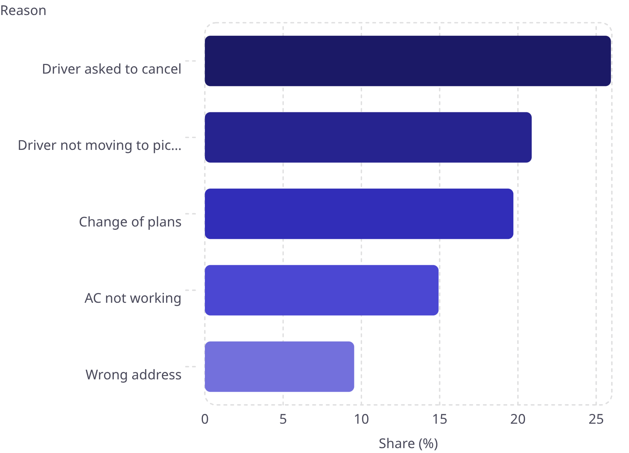
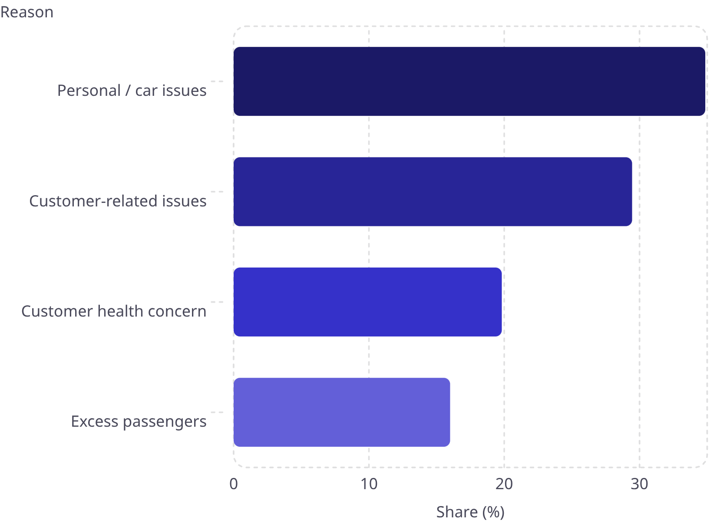
Cancellation Deep-Dive: 26.6% of Bookings Lost
Key Finding: ~26% of bookings categorized as "customer cancellations" are actually driver-induced — the driver explicitly asked the customer to cancel. This is a service quality failure, not a demand problem.
Customer Cancellation Reasons
Driver Cancellation Reasons
Scale
Driver-Induced Signal
Driver-Side Root Cause
15,332 cancelled bookings out of 40,539 total — a 26.6% cancellation rate representing material revenue leakage at ₹22M baseline.
The single largest customer cancellation reason is "Driver asked to cancel" at 25.94% — surfacing a systemic driver behavior issue misclassified as customer churn.
Personal and car-related issues account for 34.86% of driver cancellations — pointing to fleet maintenance and driver availability gaps.

Slide 8

Business Recommendations: Reducing Cancellations & Maximizing Revenue
Address Driver-Induced Cancellations
26% of "customer" cancellations are driver-prompted. Implement driver accountability scoring and real-time GPS tracking to enforce pickup compliance and reduce misclassified churn.
Optimize Fleet Allocation for Peak Demand
Deploy more Prime Sedan and Bike/E-bike units during identified peak windows (Jul 7 & 14 patterns) to capture demand spikes without service degradation or elevated cancellation rates.
Auto Category Urban Strategy
Auto's short average distance (6.21 km) signals high-frequency urban micro-trip demand. Price competitively and increase Auto availability in dense city zones to maximize throughput per driver hour.
Establish Weekly KPI Monitoring Cadence
Weekly dashboard reviews tracking cancellation rate, success rate, and revenue per vehicle type enable proactive operational decisions before problems compound.
Future Scope
Integrate real-time data feeds, build predictive demand models for peak forecasting, add geographic heatmaps for high-demand zones, and automate scheduled reporting pipelines.

Slide 9
Skills Demonstrated & Project Outcomes
Technical Skills
Analytical Skills
Data Engineering
SQL / Database
Business Storytelling
Operational Analysis
Microsoft Excel, Power Query, ETL pipeline design, data cleaning
MySQL, aggregation queries, reusable views, relational schema design
KPI analysis, root-cause investigation, trend identification
Cancellation root-cause analysis, vehicle performance benchmarking
Insight Communication
BI & Visualization
Actionable recommendation framing, stakeholder-ready reporting
Power BI, DAX, KPI dashboard design, multi-view report architecture
₹22M
26.6%
Revenue Base Identified
Cancellation Leakage Pinpointed
Gross booking value mapped across 7 vehicle categories
15,332 lost bookings with root causes segmented by type
5
26%
Dashboard Views Delivered
Driver-Behavior Signal Surfaced
Overall · Vehicle · Revenue · Cancellation · Ratings
Non-obvious finding: driver-induced cancellations misclassified as customer churn

